Slide 1
IOD Project 1:
U.S. Domestic flight cancellations in 2015
Matthew Cavanaugh

Slide 2
Problem
Flight cancellations leave millions of travelers stranded every year.
This can especially become a problem if a cancellation causes a traveller to miss a connecting flight.
Last-minute efforts to move stranded passengers often lead to even more delays and cancellations.
We will explore the reasons for flight cancellations to see if there are any useful strategies to avoid them.

Slide 3
Data source
Source - Bureau of Transportation Statistics (DOT subagency):
https://www.transtats.bts.gov/DL_SelectFields.aspx?gnoyr_VQ=FGJ&QO_fu146_anzr=b0-gvzr
This government website allows anyone to download statistics on flights by U.S. domestic carriers with dozens of selectable fields, include airport, aircraft tail number, whether or not the flight was cancelled and the reason if so, scheduled arrival and departures times, etc.
Credit to Kaggle for idea (but provided dataset had problems)
Thanks to Row Zero, a fast online word processor with no cell limit that allowed me to quickly join my downloaded data together

Slide 4
Data details
I used the year 2015 as it lacked both massive internal airline system crashes (like the ones recently experienced by Southwest) and COVID effects.
The original dataset contained 5,819,079 flights. Sounds intimidating, but Python was able to read the file smoothly. After dropping rows with invalid IATA airport codes, this was reduced to 5,813,554.
A subset was also taken of only cancelled flights, which contains 89,828 rows.
Both the full set and the subset were used, so that both totals and percentages of cancelled flights could be taken for multiple parameters such as airport, month, cancellation reason and more.

Slide 5
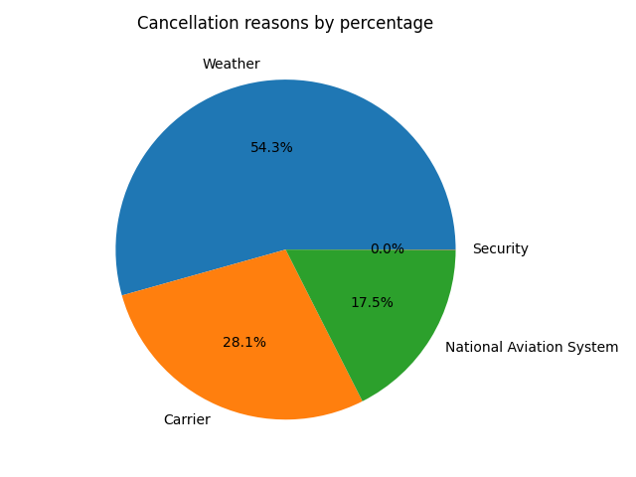
What were the most common reasons for flight cancellations?
Out of 5,813,554 scheduled flights and 89,828 cancellations:
48,819 were cancelled due to weather.
25,255 were cancelled due to the carrier.
15,732 were attributed to National Aviation System problems (these may include a range of factors such as non-extreme weather, airport operations, heavy traffic, air traffic control problems, etc).
22 were cancelled for security reasons.

Slide 6
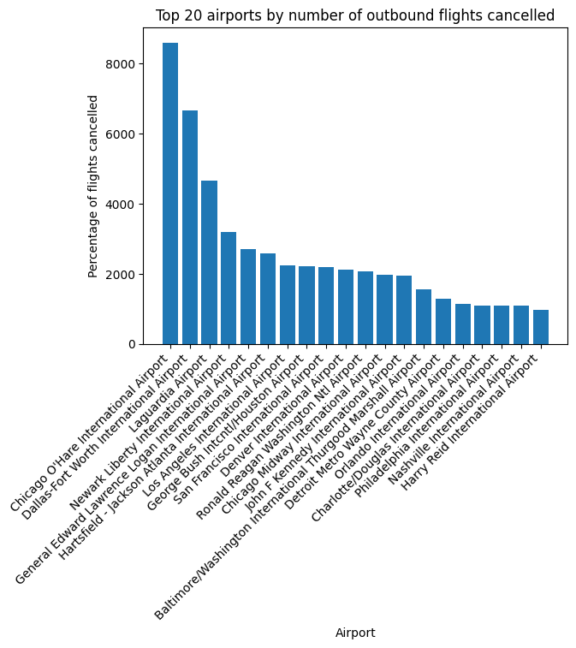
Which airports had the most departures cancelled?
No surprises here. O’Hare, Atlanta, Laguardia - these tend to be some of the busiest and most dreaded airports by travelers.

Slide 7
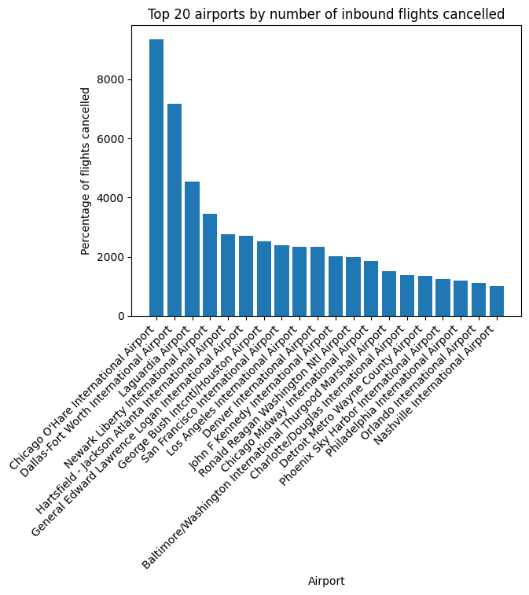
Which airports had the most arrivals cancelled?
We see most of the same suspects we did for departures.
But this isn’t a fully fair comparison, as some airports handle many more flights than others.
Let’s look at the airports with the highest percentages of cancellations.

Slide 8
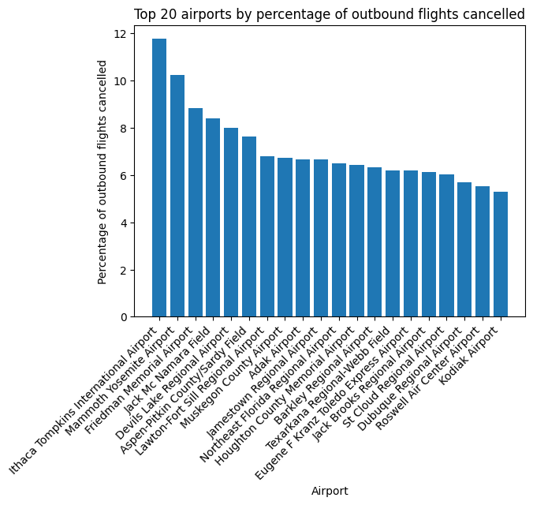
Which airports had the highest percentage of departures cancelled?
When we sort by percentage, we see that smaller airports are more cancellation-prone. This may be due to lighter staff and fewer facilities compared to major hubs.

Slide 9
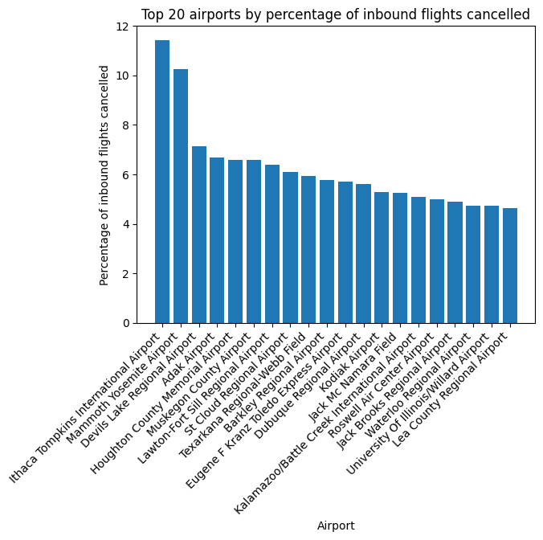
Which airports had the highest percentage of arrivals cancelled?
Many of the same airports appear again, and Ithaca Tompkins is again the clear leader.

Slide 10
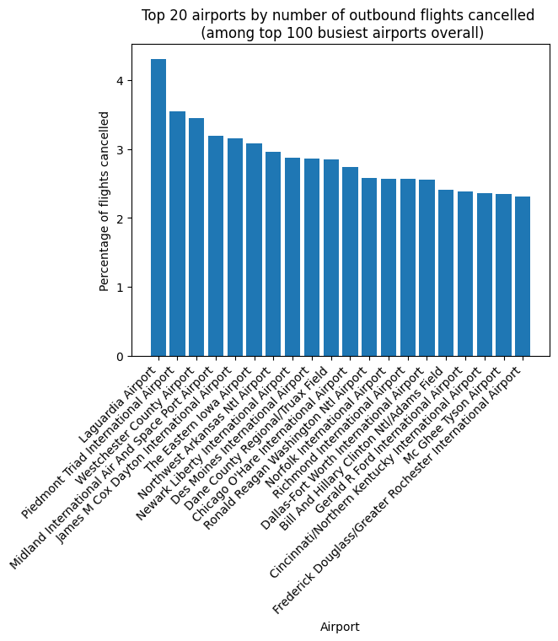
20 worst airports for cancelled departing flights (among 100 busiest overall)
That being said, you’re much less likely to fly into smaller airports. Here, I set a limit of the 100 busiest airports by total flights, and took the 20 worst airports for cancellations among those.

Slide 11
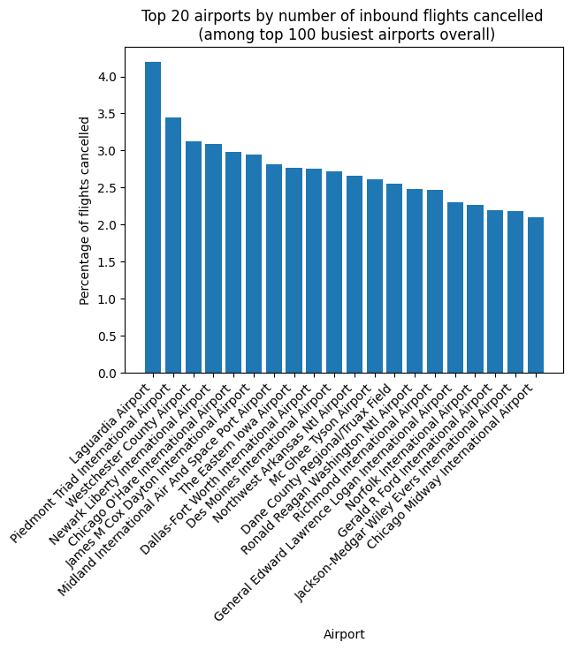
20 worst airports for cancelled arriving flights (among 100 busiest overall)
Most of the same ones again.

Slide 12
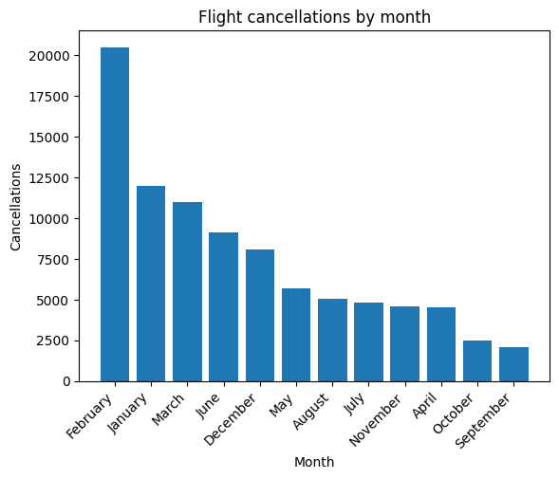
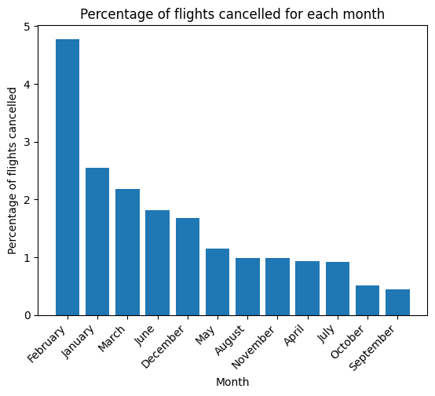
Which months had the most cancellations?
February had by far the most cancellations. This is likely the result of a polar vortex that hit the Eastern and Central U.S. that year.

Slide 13
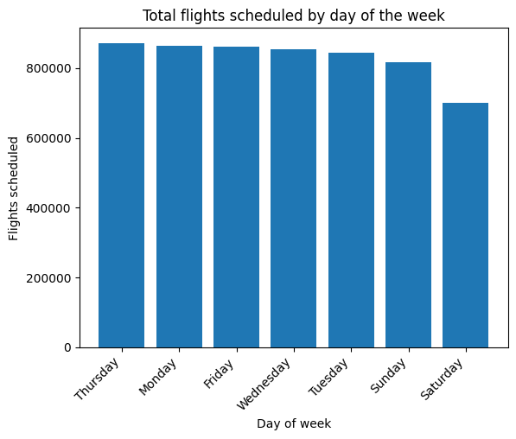
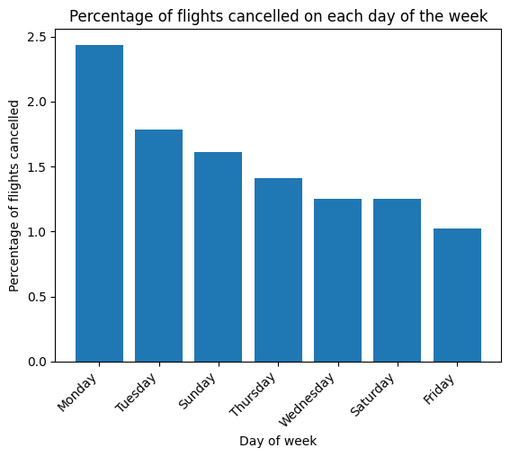
Which days of the week had the most flights cancelled?
Mondays are the most cancellation-prone day of the week, despite fewer overall flights than Thursdays.

Slide 14

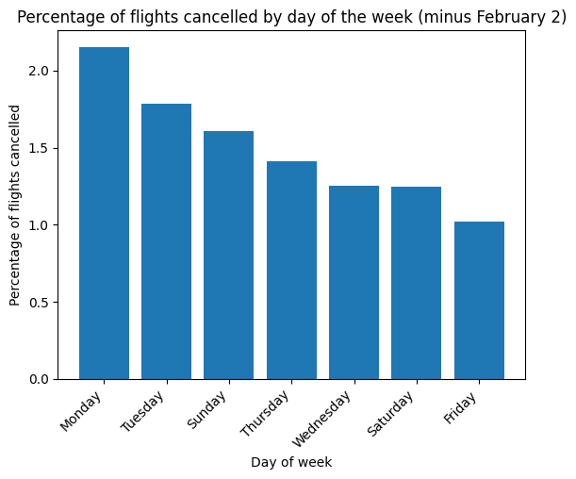
Are Mondays really the problem?
It’s worth considering that the single day in 2015 with the most cancellations was a Monday, specifically February 2, with heavy weather impacts from the polar vortex. Here is what the distribution looks like with that day excluded.
While the percentage drops from 2.44% to 2.15%, Monday was still the most cancellation-prone day of the week.

Slide 15
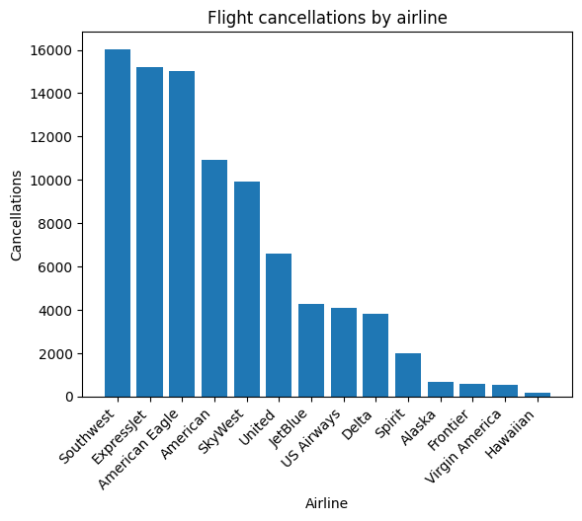
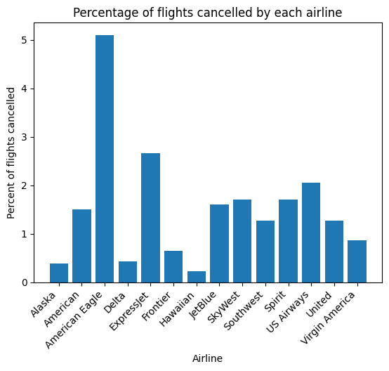
Which airlines had the most flights cancelled?
American Eagle and ExpressJet stand out as having more cancellations than any other airline. Both are regional carriers that typically use smaller planes, which may be more affected by rough weather. Let’s test that theory.

Slide 16
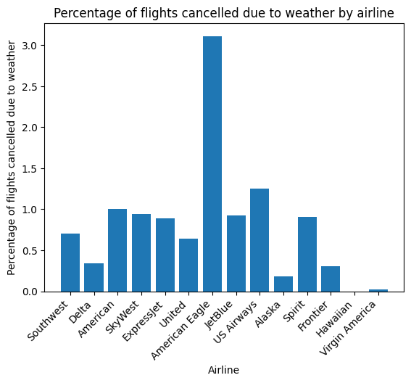
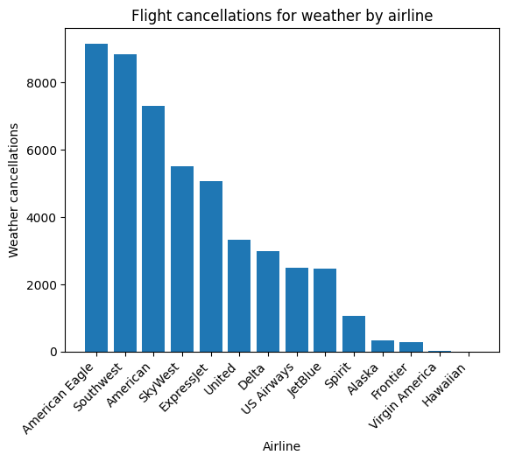
Which airlines were most impacted by weather?
We can’t say for sure whether the planes are the culprit, but it is clear that American Eagle is disproportionately affected by weather concerns, with about 3% of all scheduled flights cancelled for weather, more than double the runner-up. It also suffered more weather cancellations (in absolute numbers) than Southwest, despite only having 294,632 scheduled flights overall to Southwest’s 1,261,855. At the other end of the spectrum, Hawaiian Airlines only had one weather cancellation for the entire year.

Slide 17
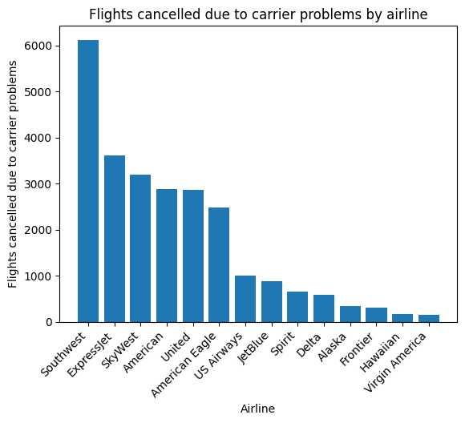
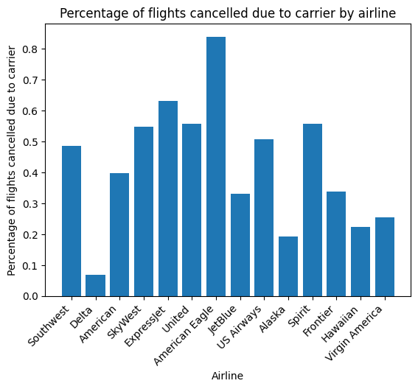
Which airlines had to cancel the most flights due to carrier (internal) problems?
There’s American Eagle and ExpressJet once again with disproportionate cancellations. Both these and SkyWest are less full-fledged airline than brands in which flights are booked by smaller companies in cooperation with major carriers. As multiple operators are involved, it may not be surprising that there are more carrier problems.
“You do it to yourself, and that’s what really hurts” - Radiohead

Slide 18
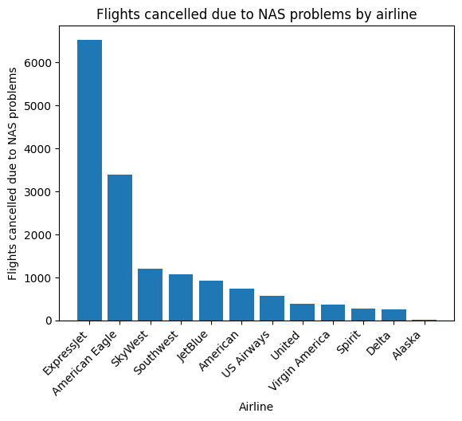
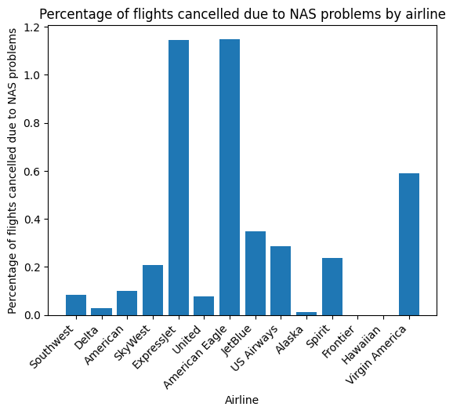
Which airlines were most impacted by National Aviation System problems?
Familiar faces once again.

Slide 19
Conclusion - How can you avoid flight cancellations?
Correlation does not necessarily imply causation, but it seems the same few factors tend to pop up together. To avoid flights cancellations, here are some actions you should take if possible:
Avoid flying in the wintertime.
Avoid flying to smaller airports.
Avoid flying on contract carriers.
Avoid flying on Mondays - try Fridays instead.
(& build high speed rail!)

